Slide 1

Incognito: Efficient Full-Domain K-Anonymity
Abdolhamid Livani Arshia Navabakbar
Jun 2024

Slide 2
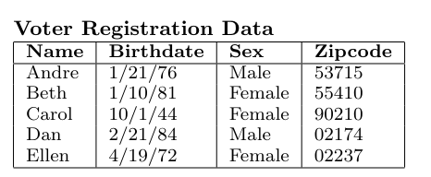
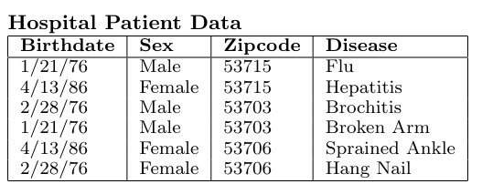
Introduction
data re-identification risks and provides a clear example to illustrate the concept
Introduction
The Risk
Numerous organizations publish microdata for various purposes like demographic and public health research.
Sensitive data is often "de-identified" by removing attributes such as Name or Social Security Number..
De-identification doesn't prevent re-identification by combining innocuous attributes with external data.
Example study: 87% of the U.S. population can be uniquely identified using 5-digit zipcode, sex, and date of birth.
Risk Demonstration:By joining the tables on Birthdate, Sex, and Zipcode, a malicious individual can determine Andre’s medical information.

Slide 3
Basic Definitions
Quasi-Identifier Attribute Set
A quasi-identifier set (Q) is a minimal set of attributes in table T that can be joined with external information to re-identify individual records with high probability.
Frequency Set
For a relation T and a set Q of n attributes, the frequency set is a mapping from each unique combination of values ⟨q0,...,qn⟩\langle q_0, ..., q_n \rangle⟨q0​,...,qn​⟩ of Q in T (the value groups) to the total number of tuples in T with these values of Q (the counts).
K-Anonymity Property
Relation T satisfies the k-anonymity property with respect to attribute set Q if every count in the frequency set of T with respect to Q is greater than or equal to k.
To check if the Patients table is 2-anonymous with respect to ⟨⟨Sex, Zipcode⟩⟩
SELECT COUNT(*) FROM Patients GROUP BY Sex, Zipcode;
If the result includes groups with count fewer than 2, Patients is not 2-anonymous with respect to ⟨⟨Sex, Zipcode⟩⟩.

Slide 4
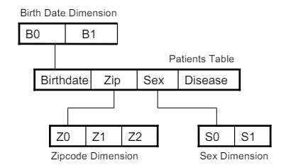
Full-Domain Generalization
Global Recoding: Maps values in quasi-identifier attribute domains to other values.
Full-Domain Generalization: Proposed by Samarati and Sweeney.
Maps the entire domain of each quasi-identifier attribute in T to a more general domain in its domain generalization hierarchy.
Ensures that all values of a particular attribute in V belong to the same domain.
Minimality and Tuple-Suppression in Full-Domain Generalization
Tuple-Suppression Threshold:
Allows for exclusion of outlier records from V.
Up to a certain number of records (maximum suppression threshold) can be excluded.
Minimality:
Goal: Ensure data is not generalized, suppressed, or distorted more than necessary to achieve k-anonymity.

Slide 5
Incognito and Full-Domain Generalization
Incognito
Star-schema including generalization dimensions for quasi-identifier attributes
Inspired by generalization framework by Samarati and Sweeney and multi-dimensional data management techniques.
Developed a core algorithm that outperforms previous algorithms for full-domain generalization.
Multi-Dimensional Data Models:
Each domain generalization hierarchy considered as a dimension.
Table T and its quasi-identifier attributes as a relational star-schema.
Example: Star schema for ⟨Birthdate, Sex, Zipcode⟩

Slide 6
Incognito and Full-Domain Generalization
Key Properties in Full-Domain Generalization
Generalization Property:
Definition: If T is k-anonymous with respect to P, then T is k-anonymous with respect to Q (where Dp≤Dq​).
Proof Concept: Many-to-one function from Dpi​​ to Dqi​​ ensures counts in the frequency set of T with respect to Q are greater or equal to those with respect to P.
Example:
If Patients table is 2-anonymous with S1​, it is also 2-anonymous with S1​, a generalization of S0.

Slide 7
Incognito and Full-Domain Generalization
Rollup and Subset Properties
Definition: If f1​ is the frequency set of T with respect to P, f2​ (frequency set of T with respect to Q) can be generated by summing counts in f1​ associated with each value set of f2​.
Example: Frequency set of Patients with respect to ⟨Birthdate, Sex, Z1⟩ can be produced by joining F1​ with Zipcode dimension table and summing counts.
Subset Property:
Definition: If T is k-anonymous with respect to Q, it is k-anonymous with respect to any subset P⊆QP.
Proof Concept: Removing any attribute from Q merges partitions or keeps them the same, ensuring counts remain same or increase.
Example:
Patients is 2-anonymous with ⟨S1,Zipcode⟩, hence it is also 2-anonymous with ⟨Zipcode⟩ and ⟨S1⟩.

Slide 8

Incognito algorithm

Slide 9

Algorithm Input & Output
Input:
Table T to be k-anonymized
Set Q of n quasi-identifier attributes
Set of dimension tables (one for each quasi-identifier in Q)
Output:
Set of k-anonymous full-domain generalizations of T

Slide 10
Step1
Initialize:
C1={Nodes in the domain generalization hierarchies of attributes in Q}
E1={Edges in the domain generalization hierarchies of attributes in Q}
queue=an empty queue

Slide 11
Step2
For each i from 1 to n:
Define a graph of generalizations: Si=copy of Ci
Identify roots: {roots}={all nodes∈Ci with no edge∈Ei directed to them}
Insert {roots} into queue, keeping queue sorted by height

Slide 12
Step3
Process Queue:
While queue is not empty:
Remove the first item from queue
If node is not marked:
If node is a root:
Compute frequency set of T with respect to attributes of node using T
Else:
Compute frequency set of T with respect to attributes of node using parent’s frequency set
Use frequency set to check k-anonymity
If T is k-anonymous with respect to attributes of node:
Mark all direct generalizations of node
Else:
Delete node from Si
Insert direct generalizations of node into queue, keeping queue ordered by height

Slide 13
Step4&5
Graph Generation:
Ci+1,Ei+1=GraphGeneration(Si,Ei)
Return:
Projection of attributes of Sn onto T and dimension tables

Slide 14

Our Implementation

Slide 15
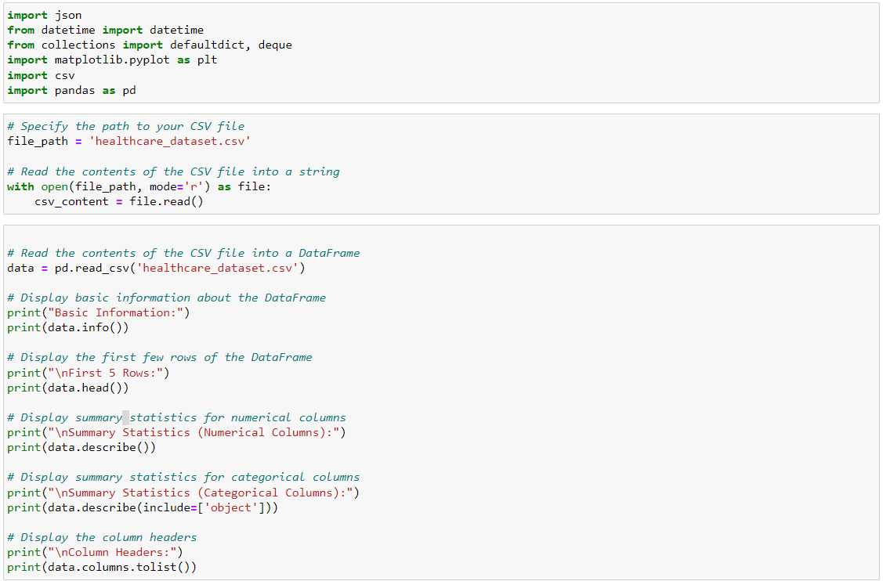

Slide 16
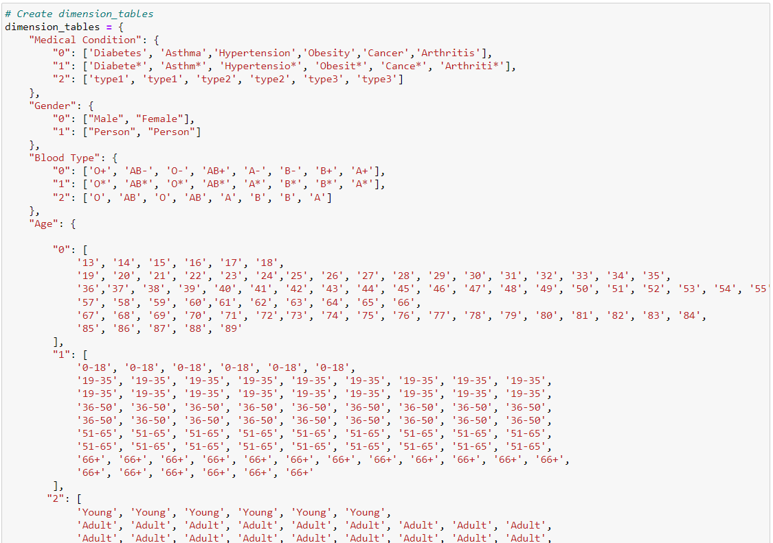

Slide 17
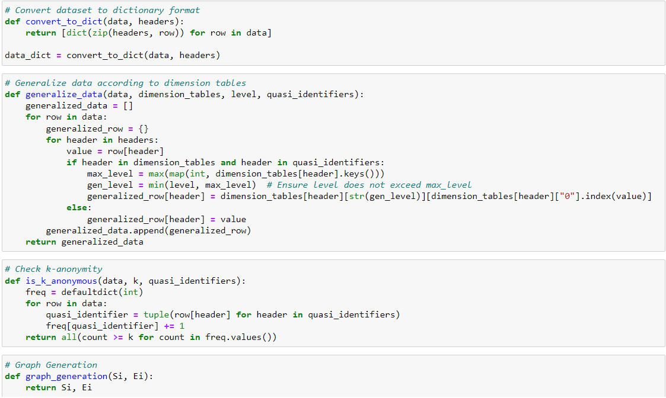

Slide 18
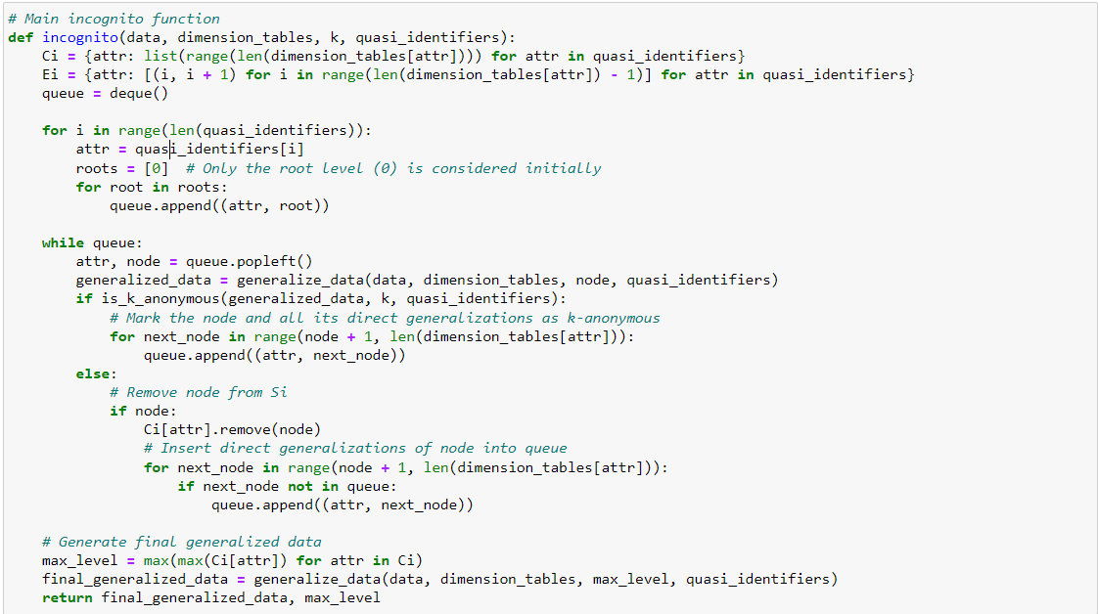

Slide 19
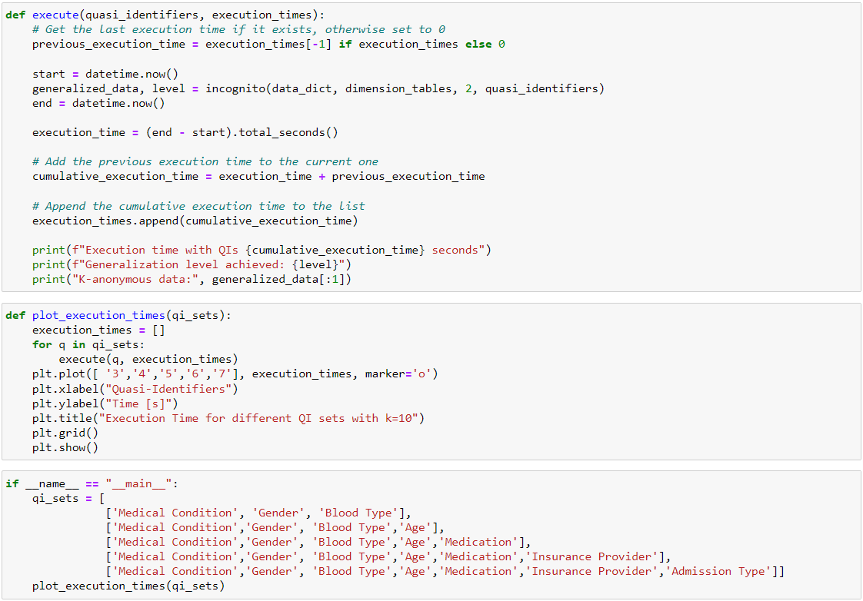

Slide 20

THANK YOU!

